Slide 1
Reconstruction
(1865-1877)

Slide 2
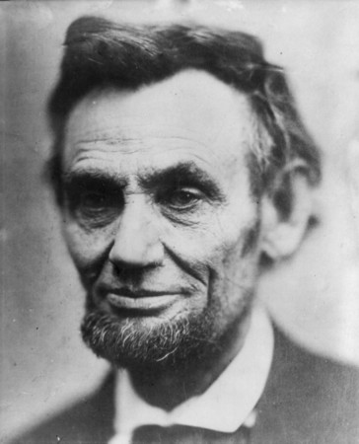
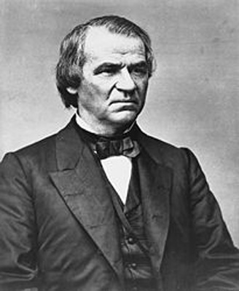
Abraham Lincoln and Andrew Johnson
ABRAHAM LINCOLN
ANDREW JOHNSON
President
Republican
Northerner (Illinois)
“Preserve the Union” (with or without slavery)
Signed the Emancipation Proclamation
Vice President
Democrat
Southerner (Tennessee)
Chosen by Lincoln during 1864 Election to win voters from border states
Only Southern Senator NOT to leave the Senate

Slide 3
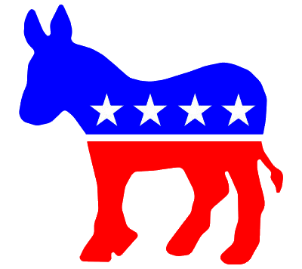

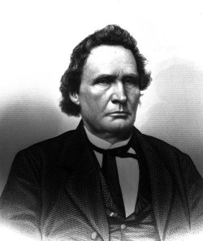
Democrats vs. Republicans (Then)
CHANGE or STAY THE SAME?
LIBERAL
MODERATE
CONSERVATIVE
RADICAL
Thaddeus Stevens
Abraham Lincoln
Andrew Johnson

Slide 4
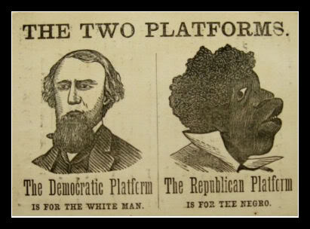
Democrats vs. Republicans (Then)

Slide 5
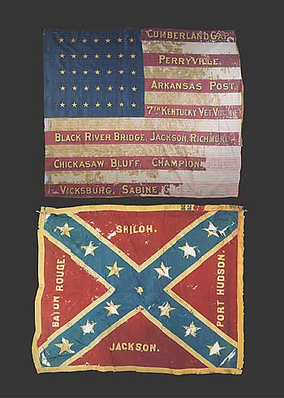
Radical Republicans
Republican members of Congress dissatisfied with policies of Lincoln and Johnson after the war
Strong abolitionists
Believed in punitive Reconstruction terms
Thaddeus Stevens in the House
Charles Sumner and Benjamin Wade in the Senate

Slide 6
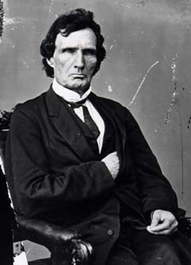
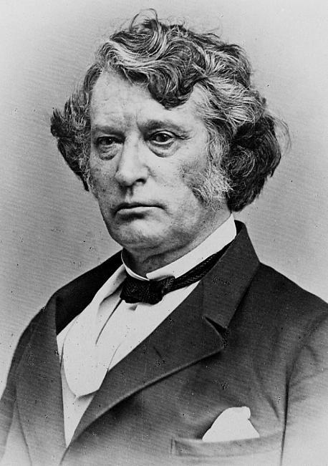
Congressional Reconstruction, 1866-77
Led by Radical Republicans
Thaddeus Stevens and Charles Sumner
Thaddeus Stevens
Charles Sumner

Slide 7
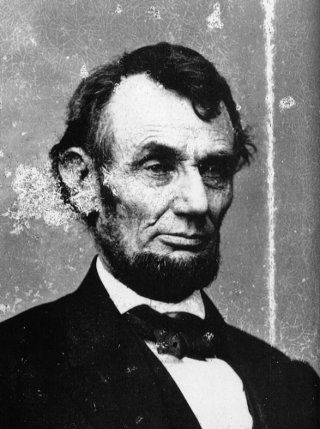
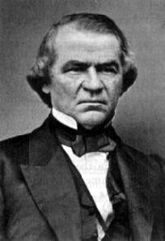
Ten Percent Plan April-December, 1865
Lincoln’s Reconstruction plan
Aka “Presidential Reconstruction”

Slide 8
Ten Percent Plan April-December, 1865
South had to:
Renounce secession
Ratify the 13th Amendment
10% of voters from 1860 must swear allegiance to Union
Confederate officers, officials, wealthy must make special request for pardon

Slide 9
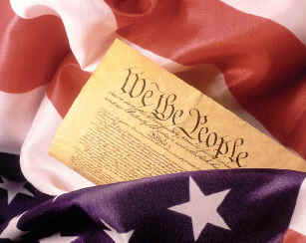
Thirteenth Amendment
1
8
6
5
This Amendment freed all the slaves. Ironically, by negating the Three-fifths Clause in the Constitution, it had the effect of increasing the representation of the Southern states in Congress. Congressional Republicans balked at this.

Slide 10
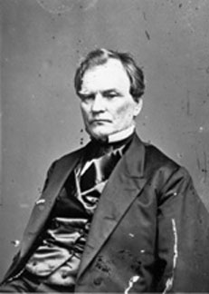
Wade-Davis bill July 4, 1864
Senator Benjamin Wade
Passed in response to Lincoln’s “Ten Percent Plan”
Introduced by Ohio Senator Benjamin Wade and Maryland representative Henry Davis, both Radical Republicans

Slide 11
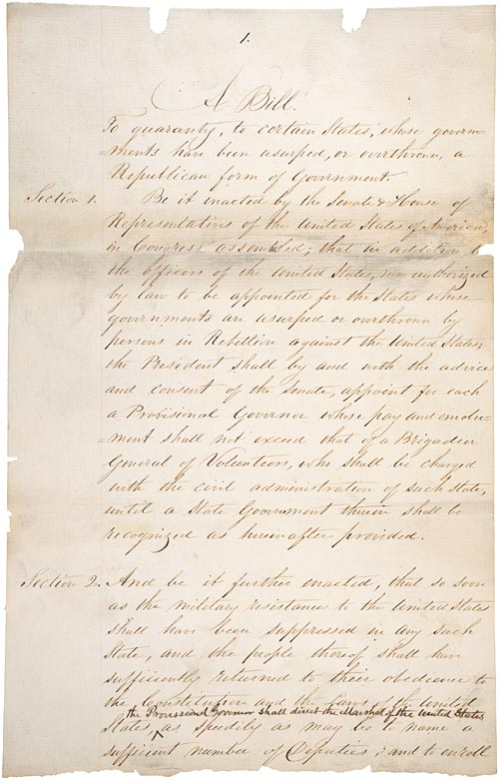
Wade-Davis bill July 4, 1864
Bill allowed a state to set up a new government and return to the Union when a majority of the white citizens took an oath of loyalty to the U.S. Constitution
And agreed to black equality.
Lincoln (favoring the ten percent plan) blocked it with a pocket veto

Slide 12
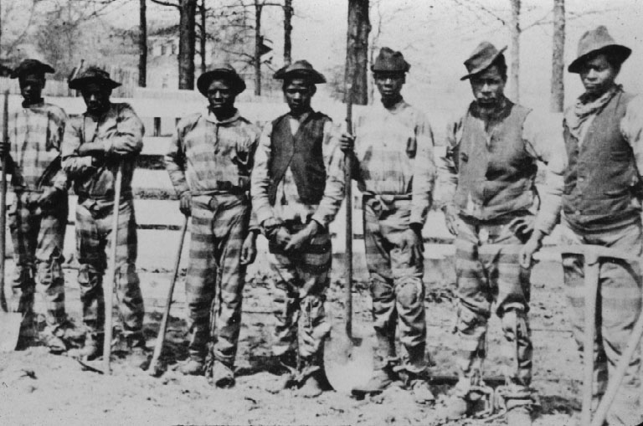
black codes 1865
Special laws passed by southern state governments immediately after the Civil War.
They were designed to control former slaves, and to subvert the intent of the Thirteenth Amendment.
They outraged Northerners.

Slide 13
Assassination of Abraham Lincoln (1865)
What happened?
Why was this significant?

Slide 14
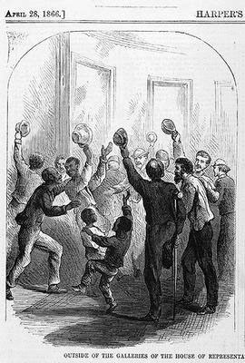
Civil Rights Act of 1866
Declared that blacks were citizens of the United States
Denied states the power to restrict African Americans' basic civil rights.
President Johnson vetoed the bill.
Congress overrode his veto

Slide 15
Fourteenth Amendment
1
8
6
6
Provided citizenship to freedmen after the Civil War and guaranteed them, and all Americans, federally protected equal rights under the law. Its provisions were used by Radical Republicans to enact a congressionally controlled Reconstruction policy for the former Confederate states.
“equal protection clause”

Slide 16
Fifteenth Amendment
1
8
7
0
Forbade all the states to deny the vote to anyone on the account of race, color, or for having been a slave. It was intended to guarantee African Americans the right to vote in the South.
voting rights

Slide 17
Congressional Reconstruction, 1866-77
South had to ratify 13th, 14th and 15th Amendment
Had to accept black citizenship
Had to accept black men voting
Put 20,000 troops in the South (to protect black voting rights)
Confederate officials, officers, soldiers could not vote
Created Freedmen’s Bureau

Slide 18
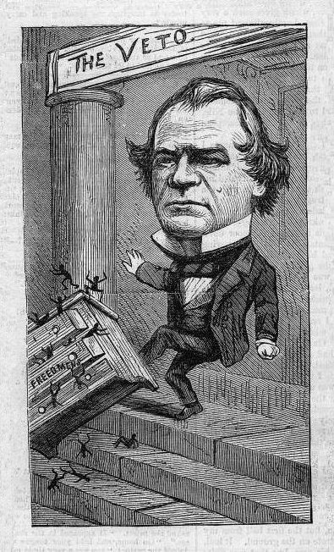
Freedmen’s Bureau
A federal postwar refugee agency set up to aid former slaves; Oliver Howard.
It provided them food, clothing, and other necessities as well as helped them find work and set up schools.
President Johnson vetoed the Freedmen's Bureau renewal bill in 1866.
Congress overrode his veto.

Slide 19
“Redeemers”
Who were they?
Why the name?
What was the “lost cause”?

Slide 20
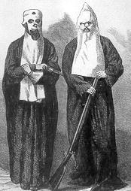
Ku Klux Klan 1866
Southerners who objected to congressional Reconstruction policies founded several secret terrorist societies
The KKK was organized in Tennessee in 1866
Became a vigilante group dedicated to driving African Americans out of politics by using intimidation and violence.

Slide 21
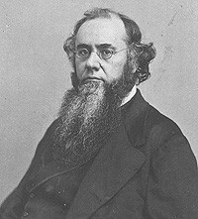
Tenure of Office Act 1867
Prohibited the president from removing without Senate approval any official who had been appointed with the consent of the Senate.
President Johnson challenged the act in 1868 when he dismissed Secretary of War Stanton. For this, the House of Representatives impeached Johnson.
Edwin Stanton,
Secretary of War

Slide 22
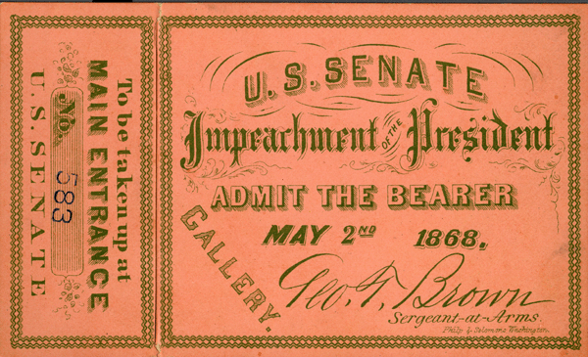
Impeachment of Andrew Johnson 1867
Impeachment means to bring charges against a public official for misbehavior in office.
The Constitution gives the House the power to impeach; the Senate the power to try.

Slide 23
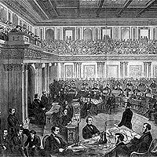
Impeachment of Andrew Johnson 1867
The House impeached President Johnson in 1867 for violating the Tenure of Office Act and other allegations.
A Senate trial failed to convict him of the charges.

Slide 24
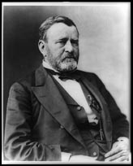
Election of 1868 and 1872
The most successful Union general, Ulysses S. Grant elected in 1868
He supported protection of the rights of ex-slaves
The former slaves contributed to the Republican victory, many voting for the first time

Slide 25
Depression and Scandals
Economic depression called the “Panic of 1873”
Government corruption:
The Credit Mobilier scandal; the Whiskey Ring; the Belknap Scandal

Slide 26
The Election of 1876
People were tired of:
Hard economic times
The scandals
Keeping federal troops in the South

Slide 27
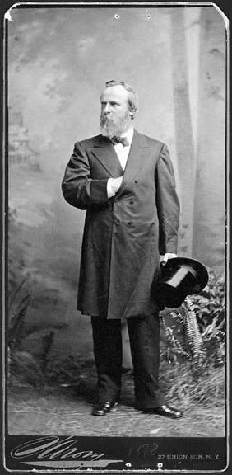
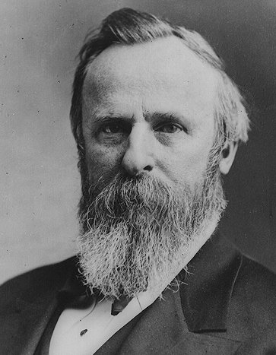
The Election of 1876
The Republicans nominated Rutherford B. Hayes (Governor of Ohio) as a reform [change] candidate

Slide 28
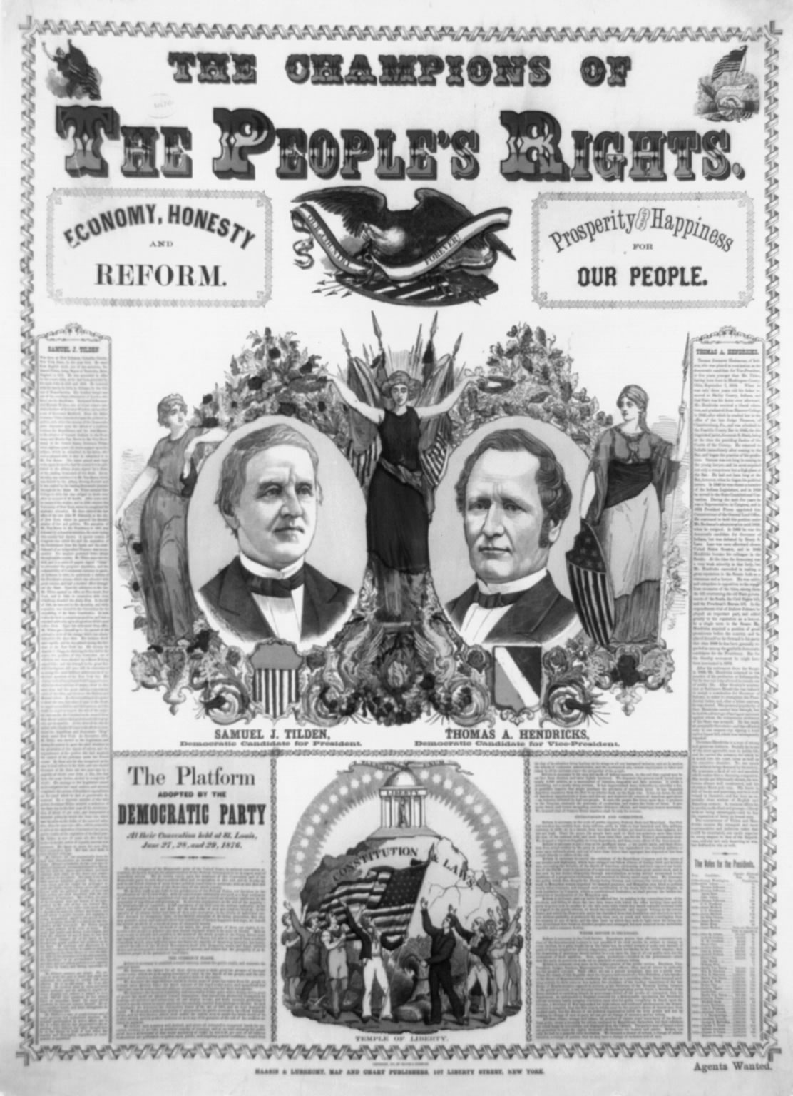
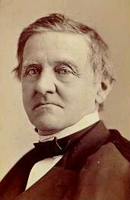
The Election of 1876
The Democrats nominated Samuel Tilden, who also promised change

Slide 29
The Election of 1876
Tilden won the popular vote but fell one short of the 185 electoral votes needed to win
Hayes took 165 electoral votes
Samuel Tilden (D)

Slide 30
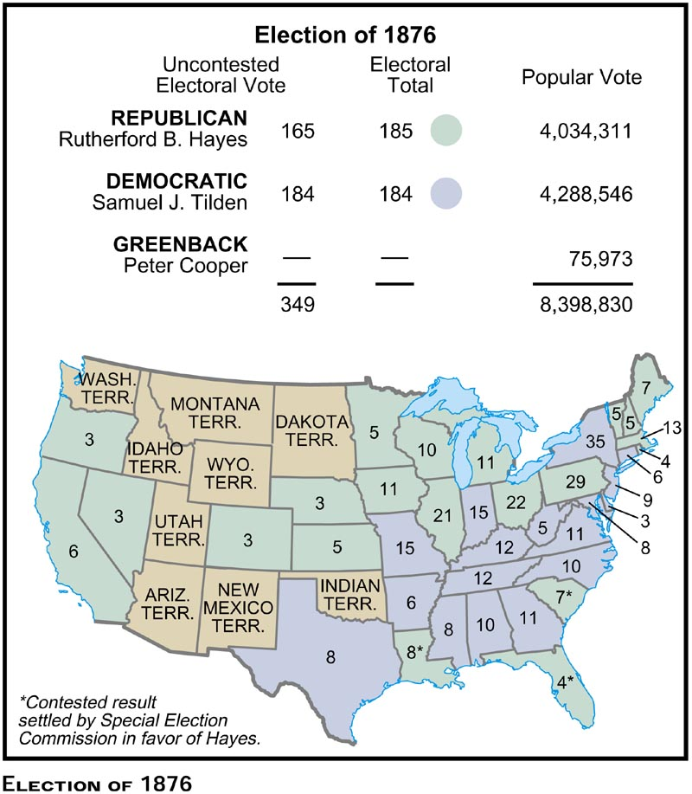

Slide 31
Twenty Electoral Votes Were Disputed
Nineteen votes were from three states that still had Reconstruction governments (South Carolina, Louisiana, and Florida)
Republican officials claimed that racist election rules took black votes away from Hayes

Slide 32
Twenty Electoral Votes Were Disputed
The two parties submitted two different sets of election returns from these states and each claimed victory.
The other disputed vote was from Oregon

Slide 33
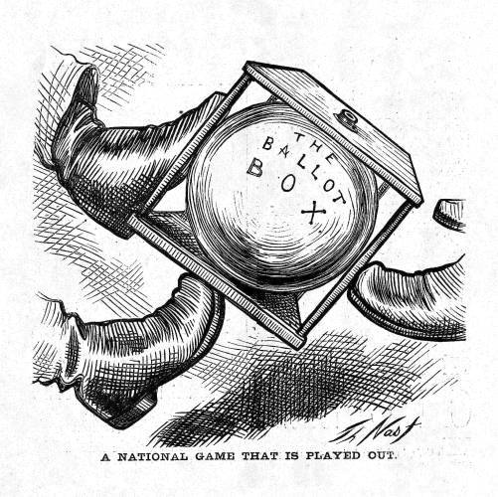

Slide 34
When an election is contested…
It first goes to the Congress to decide
In this case, the Congress split along party lines and couldn’t decide, so…
They set up a fifteen-member commission made up of ten Congressmen and five U.S. Supreme Court justices.

Slide 35
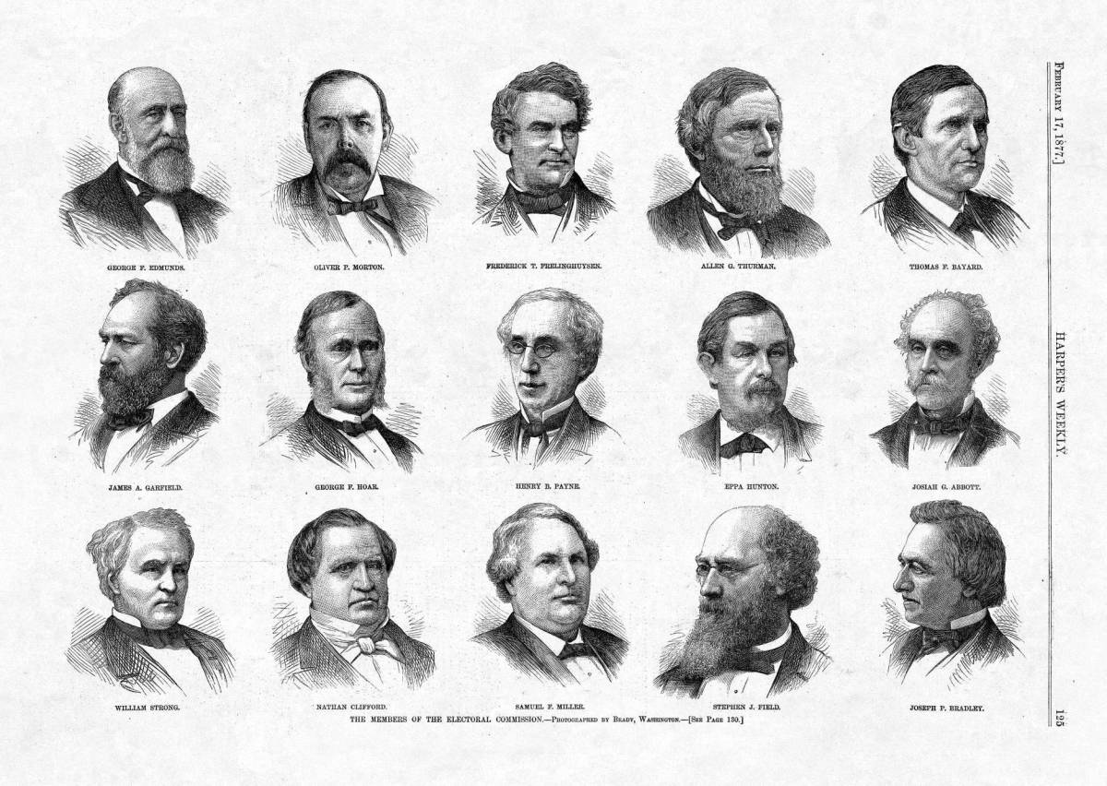

Slide 36
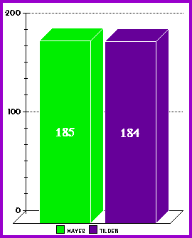
The Commission
Voted along party lines
Eight of them were Republicans
Seven of them were Democrats
They awarded the 20 disputed votes to Rutherford B. Hayes (the Republican), which gave him a 185-184 victory and the presidency

Slide 37
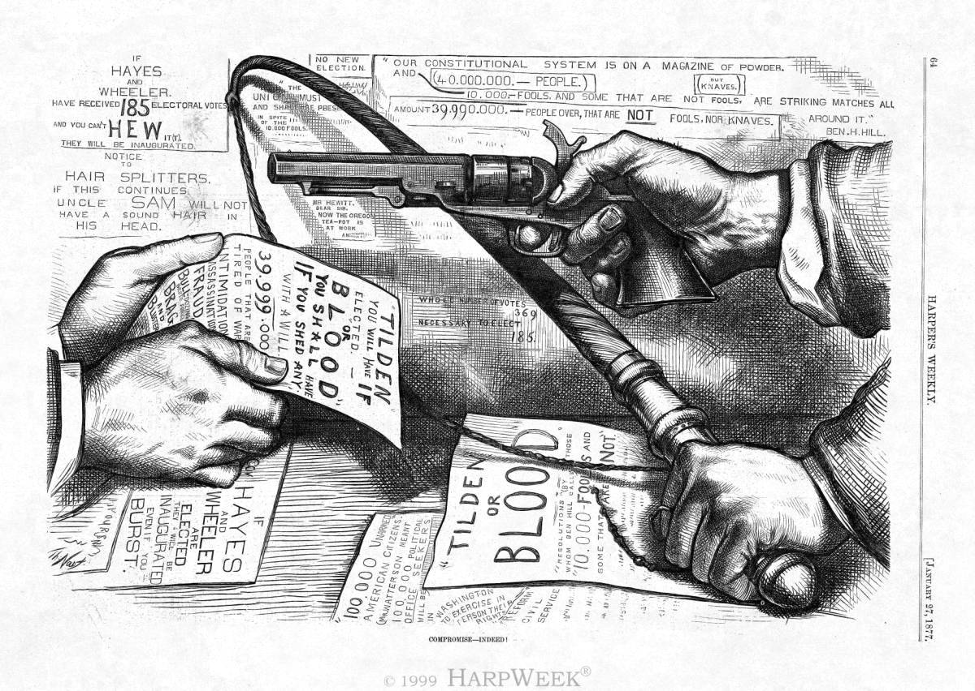
Southerners are furious and threaten to disrupt the inauguration…

Slide 38
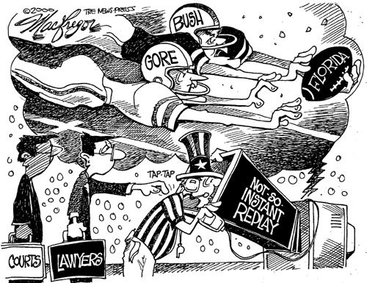

Slide 39
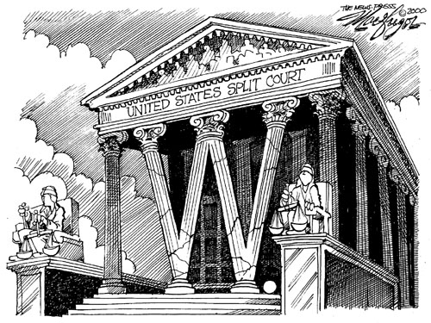

Slide 40
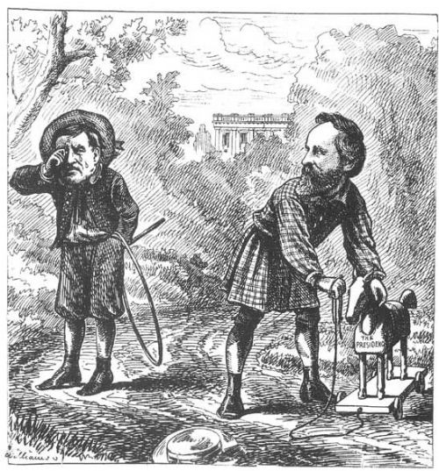
Sammy Tilden—“Boo-Hoo! Ruthy Hayes’s got my presidency and won’t give it to me.”

Slide 41
The Compromise of 1877
In exchange for a peaceful inauguration of Hayes…
Republicans agree to remove all federal troops from the southern states
This officially ends Reconstruction
And leaves freed African-Americans without federal protection

Slide 42
contract labor system
What’s going on with African-Americans and their former masters?

Slide 43
sharecropping
What was this system?
How did it work?
How did it change (or not) the social structure of the South?
What was the impact on African-Americans?

Slide 44
Reconstruction: Success or Failure?
Some historians say the Civil War and Reconstruction really do constitute a “new birth of freedom” that Lincoln talked about at Gettysburg.
Some historians say it was a miserable failure.
Was Reconstruction a second American Revolution?
Constitutionally?
Politically?
Economically?
Socially?

Slide 45
